Slide 1
CS3241 : Let There Be Light!!!
Lab #3

Slide 2
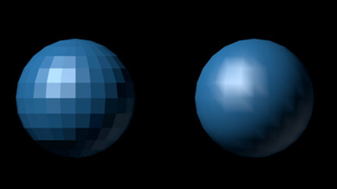
Goals
Better understanding of flat and smooth shadings
Making fun shapes
Understanding of how light interacts with surface via calculation

Slide 3
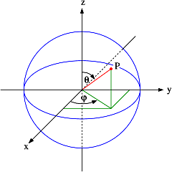

Step 1: Draw your sphere
Decompose a sphere into small polygons
  And each polygon has a few vertices
The coordinates of each vertex can be expressed by angle “theta” and “phi”
Notes:
n is the number of sections being drawn
i-variable is in the longtitudinal direction
J-variable is in the latitudinal direction

Slide 4
Step 1: Draw your sphere
Go to the function
  void drawSphere(double r)
Look into the for-loop

Slide 5
Step 1: Draw your sphere
Variable i is the movement along the latitude
Variable j is the movement along the longtitude
glVertex3d(r*sin(i*M_PI/n)*cos(j*M_PI/n),
r*cos(i*M_PI/n)*cos(j*M_PI/n),
r*sin(j*M_PI/n));
glVertex3d(r*sin((i+1)*M_PI/n)*cos(j*M_PI/n),
r*cos((i+1)*M_PI/n)*cos(j*M_PI/n),
r*sin(j*M_PI/n));
glVertex3d(r*sin((i+1)*M_PI/n)*cos((j+1)*M_PI/n),
r*cos((i+1)*M_PI/n)*cos((j+1)*M_PI/n),
r*sin((j+1)*M_PI/n));
glVertex3d(r*sin(i*M_PI/n)*cos((j+1)*M_PI/n),
r*cos(i*M_PI/n)*cos((j+1)*M_PI/n),
r*sin((j+1)*M_PI/n));

Slide 6
The Normal Vectores
Usually we can following the lecture slides, computing the vertex normal by the polygons
However, the sphere is a special case that we can compute the normals in an easier manner
The normal vector of a point on a sphere is the unit vector of the point itself
Notes:
n is the number of sections being drawn
i-variable is in the longtitudinal direction
J-variable is in the latitudinal direction

Slide 7
Step 2: Flat shading
The normal of the whole polygon is the coordinate of the center of the polygon for a sphere
Use the center of polygon to be the normal
    glNormal3d(sin((i+0.5)*M_PI/n)*cos((j+0.5)*M_PI/n),
    cos((i+0.5)*M_PI/n)*cos((j+0.5)*M_PI/n),
    sin((j+0.5)*M_PI/n));
    glVertex3d(r*sin(i*M_PI/n)*cos(j*M_PI/n),
    r*cos(i*M_PI/n)*cos(j*M_PI/n),
    r*sin(j*M_PI/n));
    glVertex3d(r*sin((i+1)*M_PI/n)*cos(j*M_PI/n),
    r*cos((i+1)*M_PI/n)*cos(j*M_PI/n),
    r*sin(j*M_PI/n));
    glVertex3d(r*sin((i+1)*M_PI/n)*cos((j+1)*M_PI/n),
    r*cos((i+1)*M_PI/n)*cos((j+1)*M_PI/n),
    r*sin((j+1)*M_PI/n));
    glVertex3d(r*sin(i*M_PI/n)*cos((j+1)*M_PI/n),
    r*cos(i*M_PI/n)*cos((j+1)*M_PI/n),
    r*sin((j+1)*M_PI/n));

Slide 8
Step 3: Smooth Shading
Set different normal vectors for different vertices
glNormal3d(sin((i+1)*M_PI/n)*cos((j+1)*M_PI/n),
cos((i+1)*M_PI/n)*cos((j+1)*M_PI/n),
sin((j+1)*M_PI/n));
glVertex3d(r*sin((i+1)*M_PI/n)*cos((j+1)*M_PI/n),
r*cos((i+1)*M_PI/n)*cos((j+1)*M_PI/n),
r*sin((j+1)*M_PI/n));
glNormal3d(sin(i*M_PI/n)*cos((j+1)*M_PI/n),
cos(i*M_PI/n)*cos((j+1)*M_PI/n),
sin((j+1)*M_PI/n));
glVertex3d(r*sin(i*M_PI/n)*cos((j+1)*M_PI/n),
r*cos(i*M_PI/n)*cos((j+1)*M_PI/n),
r*sin((j+1)*M_PI/n));
glNormal3d(sin(i*M_PI/n)*cos(j*M_PI/n),
cos(i*M_PI/n)*cos(j*M_PI/n),
sin(j*M_PI/n));
glVertex3d(r*sin(i*M_PI/n)*cos(j*M_PI/n),
r*cos(i*M_PI/n)*cos(j*M_PI/n),
r*sin(j*M_PI/n));
glNormal3d(sin((i+1)*M_PI/n)*cos(j*M_PI/n),
cos((i+1)*M_PI/n)*cos(j*M_PI/n),
sin(j*M_PI/n));
glVertex3d(r*sin((i+1)*M_PI/n)*cos(j*M_PI/n),
r*cos((i+1)*M_PI/n)*cos(j*M_PI/n),
r*sin(j*M_PI/n));
Let’s try it all together

Slide 9
Changing Lighting and Material Properties

Slide 10
Lighting
In the function “setupLighting”, we already set up the basic lightings and material properties for you
  glShadeModel(GL_SMOOTH);
  // Lights, material properties
  GLfloat ambientProperties[] = {0.7f, 0.7f, 0.7f, 1.0f};
  GLfloat diffuseProperties[] = {0.8f, 0.8f, 0.8f, 1.0f};
  GLfloat specularProperties[] = {1.0f, 1.0f, 1.0f, 1.0f};
  GLfloat lightPosition[] = {-100.0f,100.0f,100.0f,1.0f};
  glLightfv( GL_LIGHT0, GL_POSITION, lightPosition);
  glLightfv( GL_LIGHT0, GL_AMBIENT, ambientProperties);
  glLightfv( GL_LIGHT0, GL_DIFFUSE, diffuseProperties);
  glLightfv( GL_LIGHT0, GL_SPECULAR, specularProperties);
  glLightModelf(GL_LIGHT_MODEL_TWO_SIDE, 0.0);
  // Default : lighting
  glEnable(GL_LIGHT0);
  glEnable(GL_LIGHTING);
k_{a}, k_{d}, k_{s} in the lecture notes (the last entry is “alpha” for transparency)
1.0 for NOT at infinity
You can set more then 1 light
Lighting not in effect if you don’t enable it

Slide 11
Changing Material Properties for EACH OBJECT
Try looking into the function drawSphere again
float mat_ambient[] = {0.8f, 0.8f, 0.2f, 1.0f};
float mat_diffuse[] = {0.1f, 0.5f, 0.8f, 1.0f};
glMaterialfv(GL_FRONT, GL_AMBIENT, mat_ambient);
glMaterialfv(GL_FRONT, GL_DIFFUSE, mat_diffuse);
Set up the colors for different properties (ambient, diffuse, specular)
Let’s try to change the ball into red color?

Slide 12
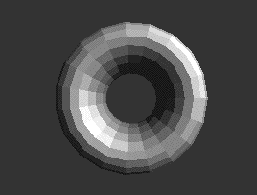
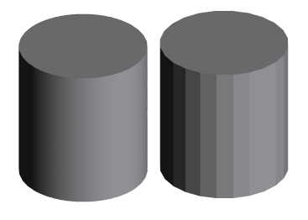
Step 4 : Create another shape
Draw more fun shapes! Torus, Hearts, cylinders, cones, etc.

Slide 13
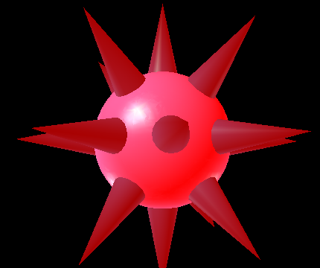
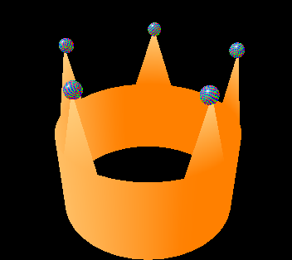
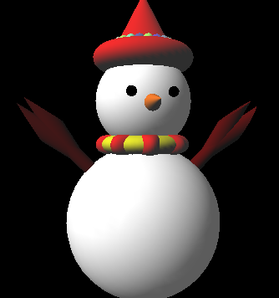
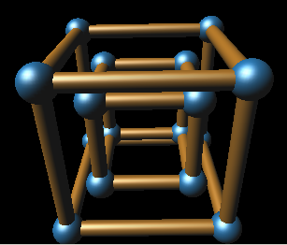
Step 5 : Composite Objects
Compose your primitive objects to form unique shapes

Slide 14
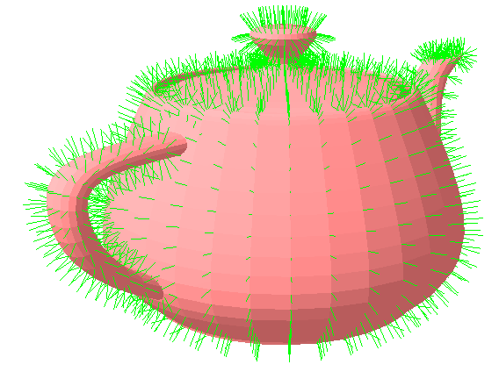
Some small tips
Avoid using square roots or power functions if there are other ways to calculate.
  These functions are really expensive and will slow down your graphic
If you really have troubles with bad lighting, write a function to draw out your normal vectors for debugging

Slide 15
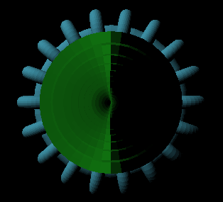
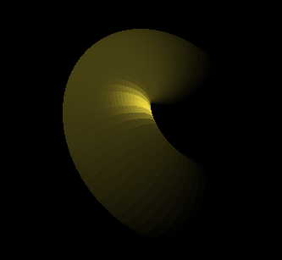
Examples of bad/half-lit shading
Try to avoid these, check your normal calculations and see whether they’re facing inwards or outwards

